Slide 1

https://www.uni-goettingen.de/en/48115.html
UNPLAB-QuGen_Ch-6[StatMod I]
The statistical model to decompose (and re-compose) the genetic value. It leads to the additive variance; you need to know the metric model for this chapter.

Slide 2
Sequential Number: #40
UNPLAB-QuGen_Ch-6[StatMod I]
Unless I explicitly state otherwise, images and cartoons are created using ChatGPT.
You may use this material free of charge under the terms of the CC BY license. This requires that you provide appropriate attribution to the author:
W. Link, University of Goettingen, Germany.
In a few cases, individual images, photographs, or similar material may be subject to a more restrictive Creative Commons license. Where this applies, it is explicitly indicated, and you must comply with the stated license terms for those items.
Please check the license information carefully before reuse. Responsibility for complying with the applicable license terms rests entirely with you.
2

Slide 3
You already know:
Populations Genetics.
GxE, h², Stability
Genetic Correlation between traits
Breeding Methodology
Keywords of this chapter:
α₁ „average effect of Allele A1“ (synonymous: „statistical additive effect α₁ of allele A1“)
α₂ „average effect of Allele A2“ (synonymous: „statistical additive effect α₂ of allele A2“).
_{ij} “dominance deviation (dom. effect) of the allele combination (locus) A1A2”.
Breeding Value.
Algebra as introduced in this chapter: ►►►
3

Slide 4
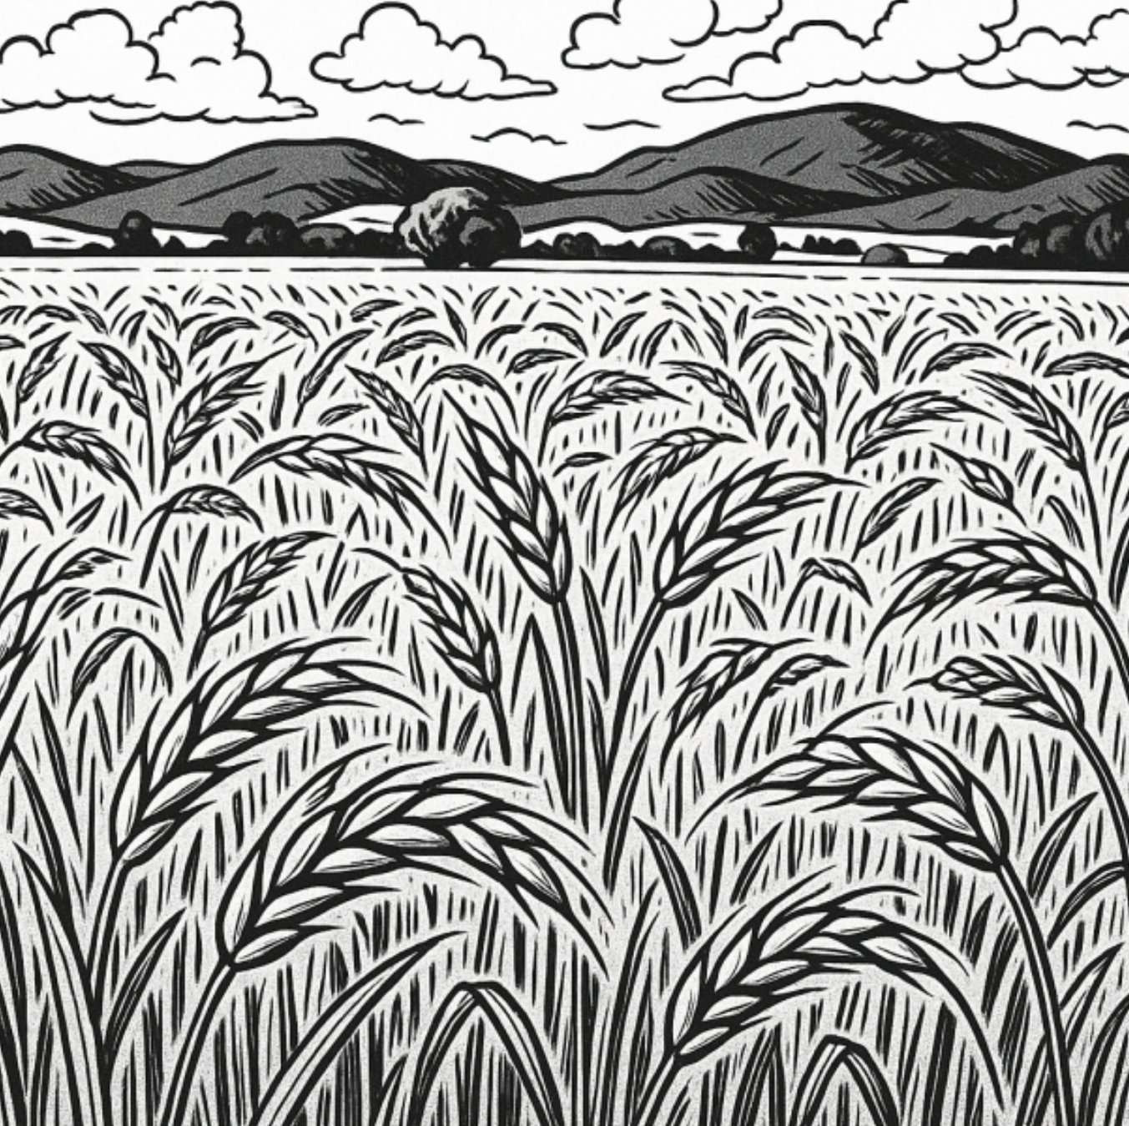
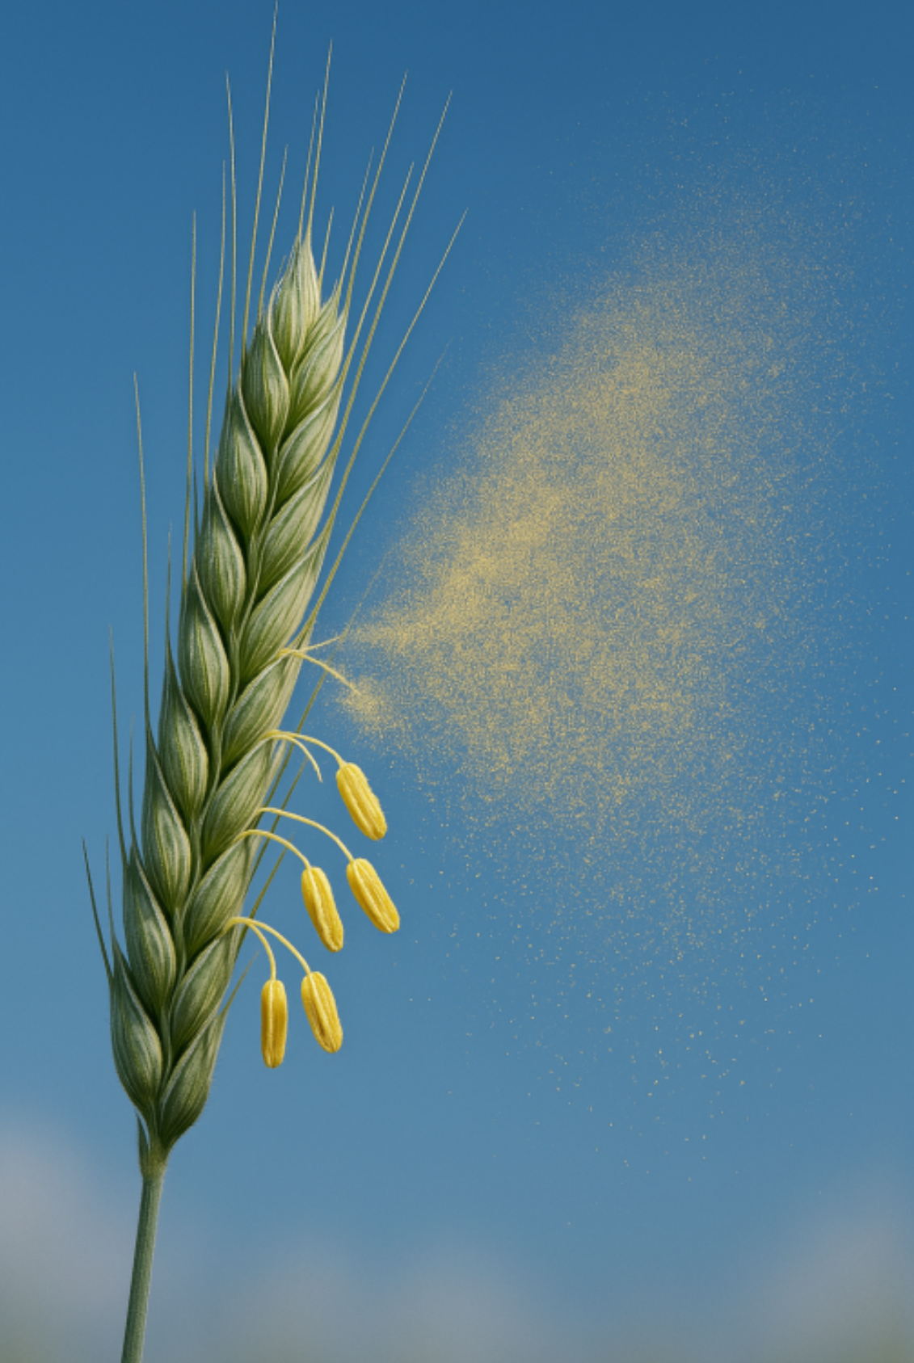
The Statistical Model originates from animal breeding; it basically describes the situation of a population* and its genetic improvement (e.g. in Recurrent Selection). DOI:10.1093/genetics/167.4.1529 (*outcrossing species)
4
Sketch of a rye population and of pollen shedding.
The parameters of the statistical model characterize the average effects of genes and gene combinations in populations with given (mostly unknown) allele and genotype frequencies such as p(A) & q(a) and P(AA), H(Aa); Q(aa). We mainly consider cases in Generalized HWE (N=∞; Random Mating, No Selection / Migration / Mutation; in case of several loci per trait: LD=0 i.e. gamete phase equilibrium; UNPLAB-PopGen_Ch-9[LD I to III]).
Parameters of the statistical models are:
► The population mean µ,
► The average effect of an allele i, α_{i},
► The dominance effect of a locus ij (effect of a pair of alleles), δ_{ij},
► The epistatic effects: interaction of non-allelic genes
i and k such as (αα)_{ik}.
You see that, different from the parameters of the Metric Model, here the parameters are written in Greek (Γκριικ) letters: µ, α, δ, (αα), … and here, the sums of effects across loci are written in capital Latin letters (A, D, AA, ...).
Remember, the sum of metric additive and dominance effects across loci is written by us in small Latin letter (a; d).

Slide 5


We are asking this question: We have a specific genotype, what will be this genotype‘s ‘value’ or merit if we use it to genetically improve our breeding population?
Rare collector postage stamps can be quite expensive.
Although they have, literally, no value ... even to note down a decent password, paper space on the stamps backside may be too small ;-) ... it is their rareness that makes them precious.
Rare goods may be in high demand, expensive, valuable. This logic applies to favourable genes, too.
If e.g. your sorghum or maize breeding population is fully resistant against
Striga hermonthica, then a specific genotype holding a resistance gene is of low value
for you. If your population is fully susceptible against this parasitic plant, then … ☺ of high value.
Striga hermonthica
5
Cf DOI 10.1080/15427528.2022.2156960.
Striga hermonthica, a devastating parasitic plant species, attacks e.g. maize and sorghum. In a similar way, Orobanche sp. attacks dicotyledonous plants (such as tomato, potato, sunflower, faba bean, cucumber, eggplant, carrot, olives, and others).

Slide 6
We are asking this question: We have a specific genotype, what will be this genotype‘s ‘value’ or merit if we use it to genetically improve our breeding population?
Rare goods may be in high demand, expensive, valuable.
We invent an example. We invent ‘true’ genetic data (zero GxE effects & error).
The focal genotype is A1A1, the A1-alleles causes monogenic resistance. Resistance via A1 and susceptibility via A2 show intermediate gene action.
Yield in case of Striga infestation ...
if A1A1 ► ‚resistant‘ type yields 30 dt/ha;
if A2A2 ► ‚susceptible‘ type yields 26 dt/ha;
if A1A2 ► ‘semi ...’ type yields 28 dt/ha (the heterozygous type).
The population that should be improved is in HWE, p(A1)=0.5 (the resistance allele is not ‘rare’ ... but see later).
Average yield µ of that population (again: HWE) is
0.25 ∙ 30 dt/ha + 0.5 ∙ 28 dt/ha + 0.25 ∙ 26 dt/ha = µ = 28 dt/ha.
Mate genotype A1A1 with that population. Offspring generation then has a new frequency p(A1)=0.75 ... because
offspring is composed from 50% A1A1 types and 50% A1A2 genotypes (¿es claro).
Yield-of-offspring is 0.5 ∙ 30 dt/ha + 0.5 ∙ 28 dt/ha = 29 dt/ha (yeah, yeah, heterogeneity-effects neglected).
This use of genotype A1A1 resulted in 29 dt/ha > 28 dt/ha; a genetic improvement of 1 dt/ha.
Nota bene: After Random Mating we get: 0.75²∙30 + 2∙0.75∙0.25∙ 28 + 0.5²∙26 = 29 dt/ha. Just as before ;-) ;-) ;-)
6

Slide 7


We are asking this question: We have a specific genotype, what will be this genotype‘s value if we use it to genetically improve our breeding population?
More formally, Algebra-based (still, p(A₁) = q(A₂) = 0.5).
Still c=28, a=2, d=0 … as you have anyway already noticed before.
The mean performance of our HWE-breeding population (‚Reference Population‘) µ,
using the Metric Effects: µ = c + p² a + 2pq d + q² (-a) = c + (p-q)a +2pqd = 28 dt/ha
Parameters and values to deduce the average genetic value (‚performance‘) of the population
Genotype | Frequency in HWE | Genetic value (yield)
A1A1 | p² = 0.25 | c+a = 30 dt(ha)
A1A2 | 2pq = 0.50 | c+d = 28 dt(ha)
A2A2 | q² = 0.25 | c+a = 26 dt(ha)
‚Value‘,
‚Penunze‘
;-)
You have noticed that this mean value of the population (here being 28 dt/ha) depended on:
► How strong is the effect of that locus (of its alleles), this is: Size of the additive effect a ?
► Is there dominance? So: What is size of ‚d‘ – absolute and relative to ‘a’?
► What are the allele frequencies p(A1) and q(A2) ?
► Is the population indeed in HWE?
7

Slide 8
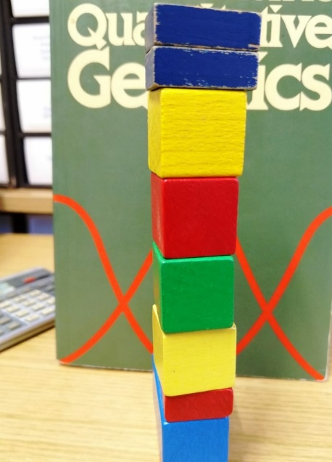
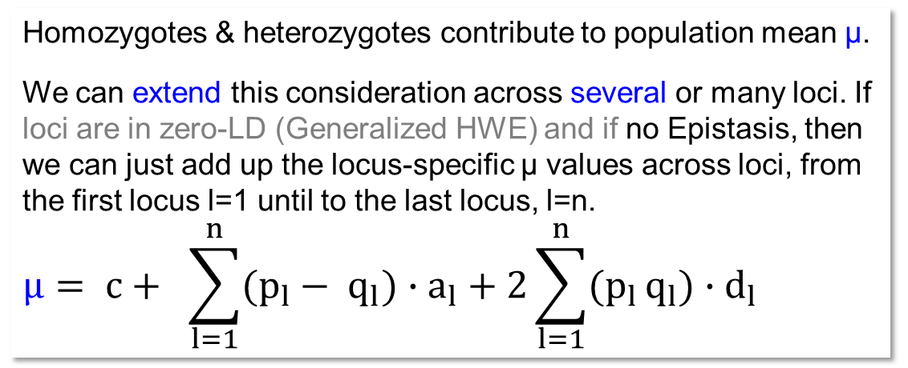
Instead of c (mean of all homozygotes; the reference value in the Metric Model) we have here as such baseline the HWE population mean µ which depends on p, q, a, d ...
Parameters and values to deduce the average genetic value (‚performance‘) of the population (yield)
Genotype | Frequency in HWE | Genetic value
A1A1 | p² = 0.25 | c+a = 30 dt(ha)
A1A2 | 2pq = 0.50 | c+d = 28 dt(ha)
A2A2 | q² = 0.25 | c+a = 26 dt(ha)
30.0
d=0, intermediate gene action
Diagram is displaying
impact of one locus
29.5
29.0
c+a
28.5
Population mean µ
c
28.0
27.5
27.0
c-a
26.5
Homozygotes & heterozygotes contribute to population mean µ.
We can extend this consideration across several or many loci. If loci are in zero-LD (Generalized HWE) and if no Epistasis, then we can just add up the locus-specific µ values across loci, from the first locus l=1 until to the last locus, l=n.
$$µ= c+ \sum_{l=1}^{n}{(p_{l}}− q_{l}){∙a}_{l}+ 2\sum_{l=1}^{n}{(p_{l}}q_{l}){∙d}_{l}$$
26.0
0.1
0.2
0.3
0.4
0.5
0.6
0.7
0.8
0.9
1.0
Allele frequency p(A1)
© WL. Photo wants to say: ‚Just‘ add up, 1+1+… makes 8.
8

Slide 9
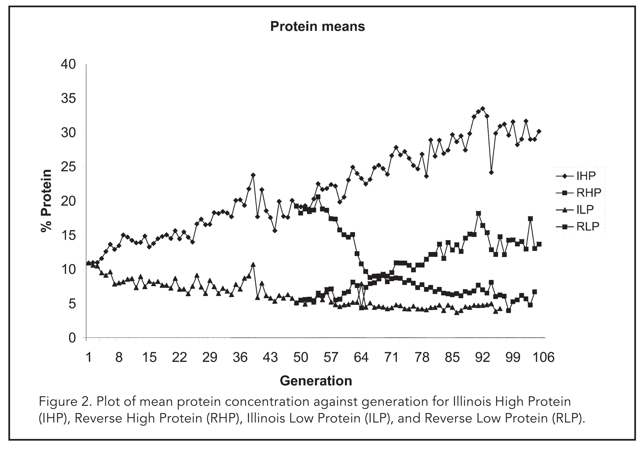
Instead of c (mean of all possible homozygotes) which was the reference value in the Metric Model we have here the parameter µ, and this one depends on p, q, a, d.
9
30.0
d=0, intermediate
Diagram is displaying
impact of one locus
DOI:10.2135/cropsci2007.04.0003IPBS
http://mooselab.cropsci.illinois.edu/longterm.html
29.5
29.0
c+a
28.5
Population mean µ
c
28.0
27.5
27.0
c-a
26.5
26.0
0.1
0.2
0.3
0.4
0.5
0.6
0.7
0.8
0.9
1.0
Allele frequency p(A1)
cf. UNPLAB-PopGen_Ch-6[Selection] page 15
Plot of mean protein concentration in seed, against Generation-of-Selection, for the famous ‘Illinois Maize High Protein’ selection path
Here, d=0.
In case of absence of allele A1, the population mean is c-a.
In case of absence of allele A2, the population mean is c+a.
See correspondence between increase of µ shown as Model and linear increase of trait expression - probably due to higher frequen-cy of alleles ‘for’ high protein content in these maize seeds.

Slide 10
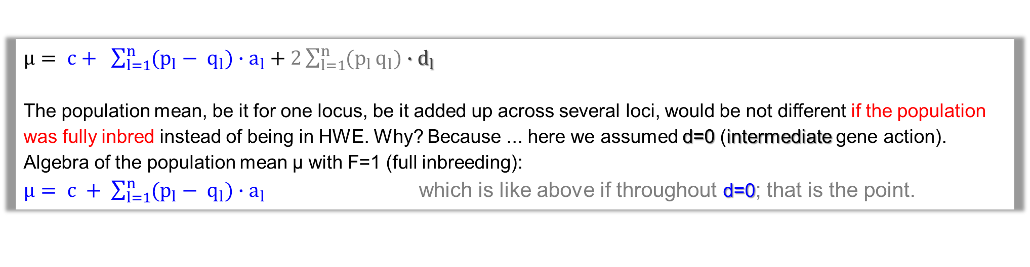
Instead of c (mean of all possible homozygotes) which was the reference value in the Metric Model we have here the parameter µ, and this one depends on p, q, a, d.
30.0
d=0, intermediate
Diagram is displaying
impact of one locus
Here, d=0.
In case of absence of allele A1, the population mean is c-a.
In case of absence of allele A2, the population mean is c+a.
If the trait was controlled by for instance three loci*, then:
Minimum possible population mean µ is
µ = c – a₁ – a₂ – a₃ .
Maximum possible population mean µ is
µ = c + a₁ + a₂ + a₃
(assume no epistasis and LD=0).
By the way, c is then the mean of all 8 possible homozygotes.
29.5
29.0
c+a
28.5
Population mean µ
c
28.0
27.5
27.0
c-a
26.5
26.0
0.1
0.2
0.3
0.4
0.5
0.6
0.7
0.8
0.9
1.0
Allele frequency p(A1)
*yeah, yeah .. it means p(A1)=p(B1)=p(C1), shown on X-axis; and, yeah yeah, per locus then a=2/3 ;-) ;-) ;-) instead of 2.0
$µ= c+ \sum_{l=1}^{n}{(p_{l}}− q_{l}){∙a}_{l}+ 2\sum_{l=1}^{n}{(p_{l}}q_{l}){∙d}_{l}$
The population mean, be it for one locus, be it added up across several loci, would be not different if the population was fully inbred instead of being in HWE. Why? Because ... here we assumed d=0 (intermediate gene action). Algebra of the population mean µ with F=1 (full inbreeding):
$µ= c + \sum_{l=1}^{n}{(p_{l}}− q_{l}){∙a}_{l}$ which is like above if throughout d=0; that is the point.
10

Slide 11
Development of HWE population mean µ along 0 < p(A1) < 1.
See how this depends on the degree of dominance: d/a=0; or d/a=1; or d/a=2.
30.5
µ>c+a
30.0
Imagine to walk on the X-axis from left to right, from 0.0 to 1.0.
The increase of the frequen-cy of allele A1 (on your walk) may be seen as result of evolution or of domestic-cation or breeding, showing the genetic improvement of the population over time for the focal genetic locus (A1 being the ‚better‘ allele).
See that with overdomi-nance (here with d=2a), max. µ is at p(A1)<1.0
(here: at p(A1)=0.75).
29.96
29.5
29.0
c+a
28.5
Population mean µ (performance, value)
28.0
c
27.5
d=0, intermediate
d=a, dominant
c-a
27.0
26.76
d=2a, overdominant
26.5
26.0
0.0
0.1
0.2
0.3
0.4
0.5
0.6
0.7
0.8
0.9
1.0
Allele frequency p(A1)
11

Slide 12
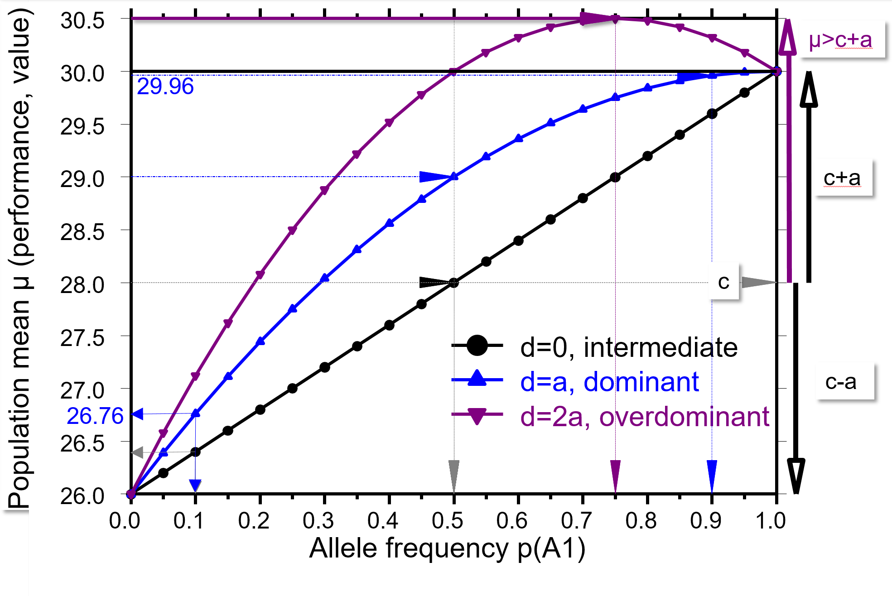
See the development of HWE population mean along increasing p(A1), from p=0 to p=1. See how this depends on the degree of dominance 0 < d/a < 1 and d/a >1.
12
With d≥0 and HWE, the increase of a population‘s mean performance µ is not linearly connected to p(A1). A specific case is full dominance, d=a.
As we have p²+2pq+q² in HWE, and as the A1A1 genotypes and A1A2 genotypes perform the same(a=d), then
µ = c+p²a + 2pqa –q²a, which is ...
µ = c+p²a + 2pqa +q²a – 2q²a, take note: //(p²+2pq+q²=1)//
µ = c+ a – 2q²a, hence:
µ = c + (1 - 2q²)a.
So, with d=a, µ develops linearly to (1 - 2q²). Then, at e.g. q(A2)=0.1 means p(A1)=0.9, max. µ is already nearly reached (29.96≈30.0). With d=0, as comparison, µ increases linearly with (2p-1), since then µ = (p-q)a = (2p-1)a.
See the case of d=2a=4, where still G(A1A1)=30dt/ha, G(A2A2)=26dt/ha, yet G(A1A2)=c+d=32dt/ha.
With overdominance, the population mean performance µ peaks at a frequency of 0 < p*(A1) < 1. The population has µ at maximum if p=p*. That maximum µ is higher than with d≤a. Both alleles are needed to form the (superior) heterozygote, hence, to have such heterozygote, condition is p(A1)≠0; q(A2) ≠0.
Peak frequency p* expressed in the notation of Population Genetics. Selection coefficients of homozygous genotypes are s_{A1A1} = d-a = 2; s_{A2A2} = d+a = 6; p* = s_{A2A2} /(s_{A1A1} + s_{A2A2}) = 6/8 = 0.75
Expressed with the Metric Model, p* = (d+a)/(2d) = (4+2)/8 = 0.75.
cf.UNPLAB-PopGen_Ch-6[Selection];
pages 24, 25

Slide 13
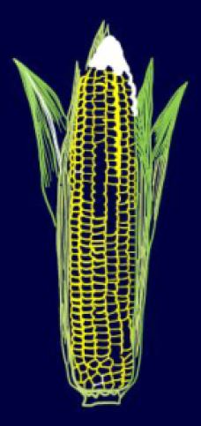
Models for the Genotypic value. Start with one locus, add up across loci later.
We are still asking: We have a specific genotype, what will be this genotype‘s value if we use it to genetically improve our breeding population?
Example: Corn (panmictic species), imagine an improvement of a population via mass selection.
Trait: Striga h. resistance. Allele frequency p(A1) = 0.1 (resistance allele is rare)
1 Assume that resistance and susceptibility show intermediate gene action a=2 dt/ha, d=0 dt/ha
2 Assume that resistance is dominant over susceptibility a=2 dt/ha; d=2 dt/ha
1 Performance: A1A1 = 30 dt/ha; A1A2 = 28 dt/ha; A2A2 = 26 dt/ha
2 Performance: A1A1 = 30 dt/ha; A1A2 = 30 dt/ha; A2A2 = 26 dt/ha
1 Population mean: µ = 0.1² ∙ 30 + 2∙0.1∙0.9 ∙ 28 + 0.9² ∙ 26 = 26.40 dt/ha
2 Population mean: µ = 0.1² ∙ 30 + 2∙0.1∙0.9 ∙ 30 + 0.9² ∙ 26 = 26.76 dt/ha
Next Step: Assume you have gametes that contain either A1 or A2, and you mate either these A1-
gametes with your population or these A2 gametes. The population delivers its gametes with
p(A1)=0.9 and q(A2)=0.1 as defined above.
1 Black: intermediate
2 Blue: dominance of resistance
© MT
We are asking: We have two specific gamete types, what will be these gamete
types’ value if we use them to genetically improve our breeding population?
13

Slide 14
Next Step: Assume you have gametes that contain either A1 or A2, and you mate either these A1-gametes with your population or these A2 gametes.
Example: Corn (panmictic species), imagine an improvement of a population via mass selection.
Trait: Striga hermonthica resistance. Allele frequency p(A1) = 0.1 (resistance allele is rare)
Assume that resistance and susceptibility show intermediate gene action
c=28 dt/ha; a=2 dt/ha; d=0 dt/ha
Population mean: µ = 26.40 dt/ha
Population mean: µ = 26.76 dt/ha
Mating of allele A1 with alleles A1 and A2 in frequency as delivered by the population
A1 with A1 = 10%, A1 with A2 = 90%; offspring: 0.1 ∙ 30 dt/ha + 0.9 ∙ 28 dt/ha = 28.20 dt/ha.
A1 with A1 = 10%, A1 with A2 = 90%; offspring: 0.1 ∙ 30 dt/ha + 0.9 ∙ 30 dt/ha = 30.0 dt/ha.
Mating of allele A2 with alleles A1 and A2 in frequency as delivered by the population
A2 with A1 = 10%, A2 with A2 = 90% ; offspring: 0.1 ∙ 28 dt/ha + 0.9 ∙ 26 dt/ha = 26.20 dt/ha
A2 with A1 = 10%, A2 with A2 = 90% ; offspring : 0.1 ∙ 30 dt/ha + 0.9 ∙ 26 dt/ha = 26.4 dt/ha
© MT
Offspring from this mating will yield 28.20 dt/ha
Offspring from this mating will only yield 26.20 dt/ha
14

Slide 15

We are still asking: We have a specific genotype, what will be this genotype‘s value if we use it to genetically improve our breeding population?
Example: Corn (panmictic species), imagine an improvement of a population via mass selection.
Trait: Striga h. resistance. Allele frequency p(A1) = 0.1 (resistance allele is rare)
Striga hermontica
Assume that resistance and susceptibility show intermediate gene action
c=28 dt/ha; a=2 dt/ha; d=0 dt/ha
Assume that resistance is dominant over susceptibility
c=28 dt/ha; a=2 dt/ha; d=2 dt/ha
Population mean: µ = 26.40 dt/ha
Population mean: µ = 26.76 dt/ha
Mating of allele A1 with alleles A1 and A2 in frequency as delivered by the population
A1 to A1 = 10%, A1 to A2 = 90%; offspring: 0.1 ∙ 30 dt/ha + 0.9 ∙ 28 dt/ha = 28.2 dt/ha.
A1 to A1 = 10%, A1 to A2 = 90%; offspring: 0.1 ∙ 30 dt/ha + 0.9 ∙ 30 dt/ha = 30.0 dt/ha.
Mating of allele A2 with alleles A1 and A2 in frequency as delivered by the population
A2 to A1 = 10%, A2 to A2 = 90% ; offspring: 0.1 ∙ 28 dt/ha + 0.9 ∙ 26 dt/ha = 26.2 dt/ha
A2 to A1 = 10%, A2 to A2 = 90% ; offspring: 0.1 ∙ 30 dt/ha + 0.9 ∙ 26 dt/ha = 26.4 dt/ha.
15

Slide 16
... value, expressed as Deviation of such offspring from the (initial) population
16
Example: Corn (panmictic species), imagine an improvement of a population via mass selection.
Trait: Striga h. resistance. Allele frequency p(A1) = 0.1 (resistance allele is rare)
Deviation of the offspring from mating Allele A1 to the population:
name it alpha 1 = α₁ „average effect of Allele A1“ (synonymous: „statistical effect of allele A1“)
Deviation of the offspring from mating Allele A2 to the population:
Name it alpha 2 = α₂ „average effect of Allele A2“ (synonymous: „statistical effect of allele A2“).
Deviation
Deviation
Deviation
Striga hermonthica
Deviation
What is the maximum possible size of α₁ with a=2 and d=0? ► α₁ can become nearly α₁ = a = 2, this is if p≈0. Then µ ≈ 26, offspring ≈ 28. With p≈1, α₂ can become nearly α₂ = -a = -2.
What is the maximum possible size of α₁ with a=2 and d=2? ► α₁ can become nearly α₁ = 2a = 4, this is if p≈0. Then µ ≈ 26, offspring ≈ 30. With p=0.5, α₂ becomes α₂ = -a/2 = -1.

Slide 17
It is indeed possible to mate the population with ‚A1-only‘. For this, employ a genotype that is homozygous A1A1.
It is indeed possible to mate the population with ‚A2-only‘. For this, employ a genotype that is homozygous A2A2.
Deviation of the offspring due to mating (gametes with) Allele A1 to the population:
Name it alpha 1 = α₁ „average effect of Allele A1“ (synonymous: „statistical additive effect α₁ of allele A1“)
Deviation of the offspring from mating (gametes with) Allele A2 to the population:
Name it alpha 2 = α₂ „average effect of Allele A2“ (synonymous: „statistical additive effect α₂ of allele A2“).
Enjoy the self-confident handling of parameters that many people only know vaguely.
17

Slide 18
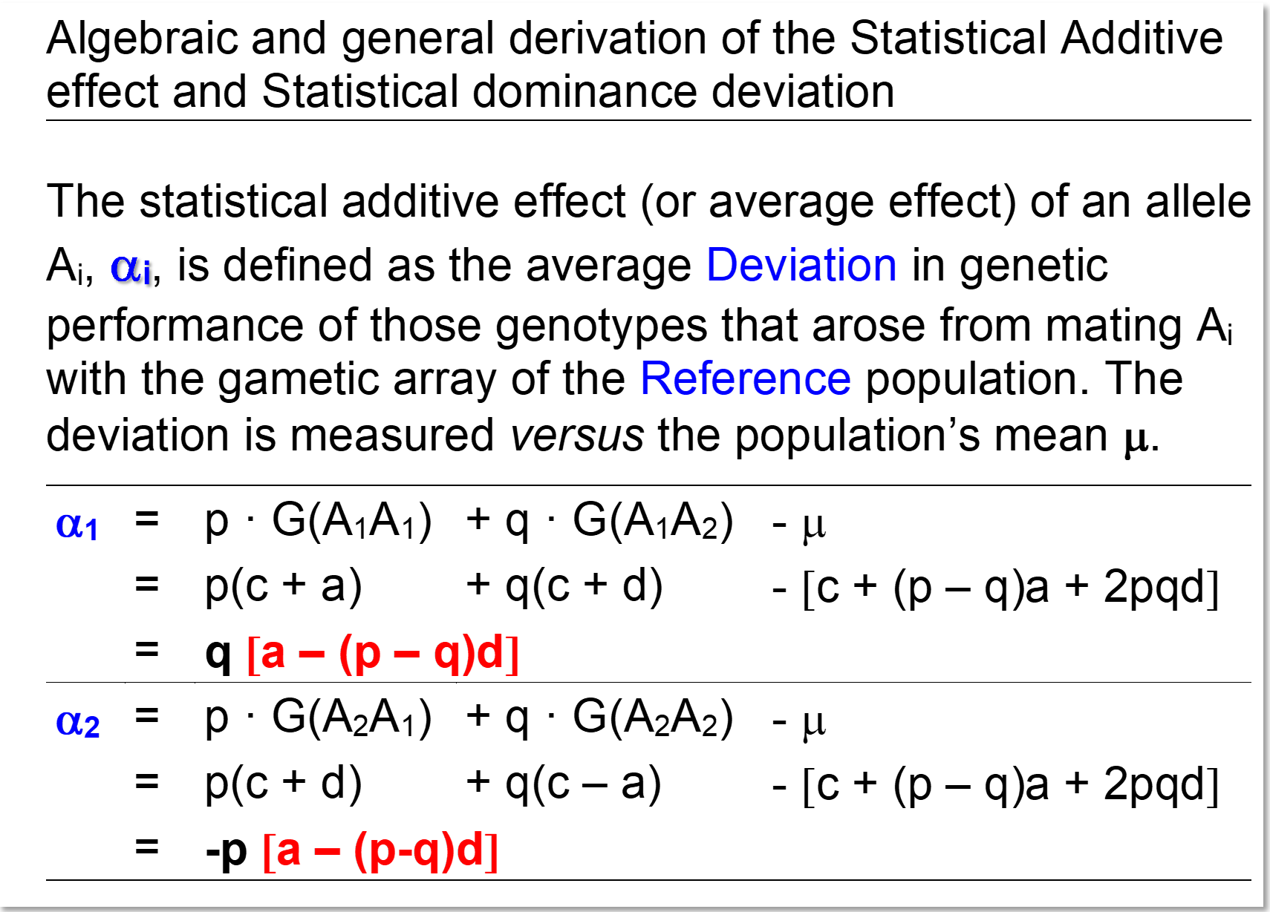
What is a genotype‘s value for Breeding (HWE, random mating situation)?
Algebraic and general derivation of the Statistical Additive Effects and of the Statistical Dominance Deviations
The statistical additive effect of an allele A1 tends to be the larger, the more frequent the other allele (A2) is:
α₁ = q[a-(p-q)d]
The statistical additive effect of an allele A2 tends to have a larger size if …
(in case of d=0) the other allele (A1) is frequent …
(in case of d=a) the other allele (A1) is at p=q; at intermediate frequency
α₂ = -p[a-(p-q)d]
18

Slide 19

What is a genotype‘s Value for Breeding (HWE, random mating situation)?
If d=0, then α₁ can maximally be α₁ = a
(this is if q≈1; hence, if A₁ is very rare and so A₂ is ubiquitous);
If d=a, then α₁ can even be α₁ = 2a (this is if q=1).
With overdominance, i.e. d > a, then may be α₁ > 2a, even.
Different from metric model, the ‘statistical dominance devia-tions’ δ.. exist for each genotype, be it heterozygous, be it ho-mozygous. These delta effects δ.. are negative for homozy-gotes and positive for heterozygous genotype (presumed d≥0).
If p=q=0.5, then the ‚positive‘ dominance deviation δ₁₂ of a heterozygote reflects half of its single-locus heterosis (half of d); otherwise δ₁₂ reflects smaller shares of that locus‘ heterosis, since δ₁₂=2pq ∙ d is maximum at p=q=0.5.
© Henri Laugel
The ‚positive‘ dominance deviation of the heterozygous genotype is its reluctant ;-) admission that, as a genotype, it inherits less ‘well’ than it (per se) genetically performs (impostor, show-off; Angeber).
19

Slide 20
What is a genotype‘s Value for breeding (HWE; random mating situation)?
The ‘statistical dominance deviations’ such as δ₁₂ are the difference between the genetic (genotypic) performance (trait expression) of a genotype and its value for breeding.
Take the dominant-recessive case.
A1A2 in our example is then phenotypically resistant, since susceptibility is recessive. Yet, genotype A1A2 inherits both alleles (in 1:1 ratio). Hence, its two alleles realize - judged from our ‘reference’ population - average (aka statistical) effects of ...
α₁ = q [a – (p – q)d] = 3.24dt/ha
α₂ = -p[a – (p – q)d] = -0.36 dt/ha.
A1A2 has a value for breeding of α₁ + α₁₂; this is
3.24 + (-0.36) = 2.88 (seen as deviation from µ).
A1A2 has a breeding Value of µ + α₁ + α₁₂; this is
26.76 + 2.88 = 29.64 (seen as ‘Value’; performance).
Since it inherits both alleles, its merit for breeding is smaller than its own genotypic (per se) performance.
δ₁₂ = 30 – (26.76 + 2.88) = 2pqd = 2∙0.1∙0.9∙2 = 0.36
Sometimes, the difference between α₁ and α₂ is called
‚average effect of gene substitution‘ α
α = α₁ - α₂ = [a – (p – q)d]
(a bit tricky to always get it - whether it is α or α₁ or α₂)
DOI: 10.3389/fgene.2012.00030
20

Slide 21

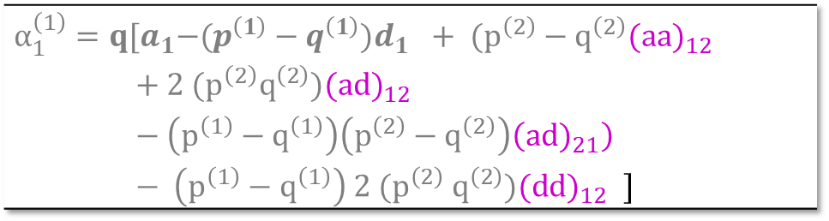
What is a genotype‘s Value for breeding (HWE, random mating situation)?
In the case of intermediate gene action, the difference between α₁ and α₂ is constant, α = α₁ - α₂ = a, because
q -(-p)=1; unlike in the dominant-recessive case, where the difference is not constant; but (if a=d), this differ-rence is: c[a – (p – q)d] = 2qa. Hence, α can be maximum 2a and minimum 0 then.
Nota bene:
The average effect of a gene substitution α = α₁ - α₂ fully ‚contains‘ the metric additive effect a; and a fraction of the metric dominance effect d. Hence, the statistical dominance effects contain only that much of the d effect as was not yet ‚consumed‘ by α = α₁ - α₂.
This ‘rule’ extend to statistical epistatic effects, see as example ☺ (ISBN: 9780878934812 Chapters 4, 5)
$α_{1}^{\left(1\right)}=q{[a}_{1}−(p^{\left(1\right)}−q^{\left(1\right)}{)d}_{1 }+ (p^{\left(2\right)}−q^{\left(2\right)}(a{a)}_{12 }$
$+ {2 (p}^{\left(2\right)}q^{\left(2\right)})(ad)_{12 }$
$− \left(p^{\left(1\right)}−q^{\left(1\right)}\right)\left(p^{\left(2\right)}−q^{\left(2\right)}\right)\left(a{d)}_{21}\right)$
$− \left(p^{\left(1\right)}−q^{\left(1\right)}\right) {2 (p}^{\left(2\right)} q^{\left(2\right)})(d{d)}_{12 }]$
Sometimes, the difference between α₁ and α₂ is called
‚average effect of gene substitution‘ α
α = α₁ - α₂ = [a – (p – q)d]
21

Slide 22
‘Visualize’ the Statistical Model.
The one ........... the other gamete
Additive effects
Locus 1
A_{i}
A_{j}
α_{i}
α_{j}
α_{k}
α_{l}
Locus 2
B_{k}
B_{l}
Additive x Additive effects
The one ........... the other gamete
Dominance effects
δ_{ij}
α_{j}α_{k}
α_{i}α_{k}
α_{i}α_{l}
δ_{kl}
α_{j}α_{l}
Reminder.
Additive effect = statistical additive effect = average effect = α_{i}. That’s the ave-rage effect of allele ‘i’ if in-herited onto offspring (when comparing offspring with Reference Popul.).
Additive x Dominance effects
Dominance x Dominance effects
(αδ)_{ijk}
Centromere
(αδ)_{ikl}
(αδ)_{jkl}
(δδ)_{ijkl}
(αδ)_{ijl}
Caution: The statistical additive x additive (α_{i}α_{k}) epistatic effect is not only included in double homozygous genotypes. This is different ►statistical model ►metric model. Each single allele i (A1 or A2) ‘has’ in each genotype (homozygous or heterozygous) a potential α_{i}α_{k} as well as α_{i}α_{l} epistatic effect. Similarly, all genotypes, even the homozygous ones, have statistical dominance deviations as seen earlier.
22

Slide 23

Visualize the statistical model.
Gamete 1
Gamete 2
Additive effects
Locus 1
A_{i}
A_{j}
α_{i}
α_{j}
α_{k}
α_{l}
Locus 2
B_{k}
B_{l}
Dominance effects
Additive x Additive effects
δ_{ij}
α_{j}α_{k}
α_{i}α_{k}
α_{i}α_{l}
δ_{kl}
α_{j}α_{l}
No, no. You don't neces-sarily have to memorize it this, it's just for illustra-tion, as an inspiring background scenery ;-)
Additive x Dominance effects
Dominance x Dominance effects
(αδ)_{ijk}
Centromere
(αδ)_{ikl}
(αδ)_{jkl}
(δδ)_{ijkl}
(αδ)_{ijl}
= qw[(aa)₁₂ – (v-w)(ad)₁₂ – (p-q)(ad)₂₁ + (p-q)(v-w)(dd)₁₂]
… by the way, v and w are the allele frequencies at the second locus.
Again: Statistical Effects of higher hierar-chical order include parts of the Metric Effects of lower hierarchical order ….
$${(αα)}_{1.1}^{(12)}$$
23

Slide 24
Now let's shed our shyness and so-to-say call a spade a spade: The value of a genotype for breeding in the discussed sense is what is called a genotypes’
Breeding Value. The breeding value is termed ‚A‘ … indicating ‚additive‘.
A is that share of a genotypes‘ own value G (its genotypic superiority or inferiority) ... A is that share that it inherits to the next generation via its gametes (aka alleles) ... ¡ .. when being mated with the Reference Population (with its p, q per locus).
The dominance deviation D is the gap between G and A:
D = G – A
So: The dominance deviation is what a genotype ‚has‘ - but doesn't inherit in that setting.
... we in nearly all cases ignore or neglect epistasis, just to make life easier.
Breeding Value
24

Slide 25
Now let's shed our shyness and so-to-say call a spade a spade: The value of a genotype for breeding in the discussed sense is what is called a genotypes’
Breeding Value. The breeding value is termed ‚A‘ … indicating ‚additive‘.
A is that share of a genotypes‘ own value G (its genotypic superiority or inferiority) ... A is that share that it inherits to the next generation via its gametes (aka alleles) ... ¡ .. when being mated with the Reference Population (with its p, q per locus).
The dominance deviation D is the gap between G and A:
D = G – A
Remember: It is possible to mate the population with ‚A1-only‘. Employ a genotype that is homozygous A1A1. This genotype then inherits only this effect; α₁.
But: !twice!, because with both-of-its alleles.
At this locus, its Breeding Value is 2α₁ = 2q [a – (p – q)d] = 6.48dt/ha in our invented Corn-Striga-example (where we had, as one example, p=0.1 and a=d=2)
25

Slide 26
The value of a genotype for breeding in the discussed sense is what is called a genotypes’ Breeding value.
Writing these capital Latin letters D = G – A ... indicated summation across those
loci that influence the genetic variation of the focal trait. So …
A = µ + [1st locus] α_{i} + α_{j} + 2nd locus] α_{i} + α_{j} + [3rd locus] α_{i} + α_{j} + etc.;
i and j may indicate homozygous or heterozygous genotype (we neglect epistasis).
►Oftentimes A is presented as ‘value’: A = µ + α_{i} + α_{j} et cetera
►Oftentimes A is expressed as …
… ‘deviation’ from the population mean µ, A = µ + α_{i} + α_{j} et cetera
in this case we should appreciate it as ‘effect’ instead of as ‘value’.
You know, the mean of values is usually µ≠0; yet, the mean of effects is indeed µ=0.
26

Slide 27
From here you may go to UNPLAB-QuGen_Ch-7[Stat Mod II]
G = A + D
27
27

